Slide 1
Linux Kernel Compilation

Slide 2
Linux
Linux is not an Operating System.
• Linux is a kernel.
• A kernel is a program that allocates and controls hardware and software resources in a system.
• Linux Distributions use the Linux kernel together with the GNU Operating System.

Slide 3
Linux Kernel- Types of releases
The Linux kernel is currently maintained by
Linus Torvalds and a few hundred developers.
• Releases are numbered in a very ordered fashion.
– major.minor.patchlevel
• Odd minor numbers are development kernels
– 3.18.7 latest stable kernel
– 4.0 latest development kernel

Slide 4
Linux Kernel- Versions
2.6.32.65
3.18.7
Major Number. Minor Number. Revision .Stable Version
Patch Level

Slide 5

Linux Kernel Maintener

Slide 6
Linux Kernel Categories
Prepatch
Prepatch or "RC" kernels are mainline kernel pre-releases that are mostly aimed at other
kernel developers and Linux enthusiasts. They must be compiled from source and usually
contain new features that must be tested before they can be put into a stable release.
Prepatch kernels are maintained and released by Linus Torvalds.
• Mainline
Mainline tree is maintained by Linus Torvalds. It's the tree where all new features are
introduced and where all the exciting new development happens. New mainline kernels are
released every 2-3 months.
• Stable
After each mainline kernel is released, it is considered "stable." Any bug fixes for a stable
kernel are backported from the mainline tree and applied by a designated stable kernel
maintainer.
• Longterm
There are usually several "longterm maintenance" kernel releases provided for the
purposes of backporting bugfixes for older kernel trees. Only important bugfixes are
applied to such kernels and they don't usually see very frequent releases, especially for
older trees.

Slide 7
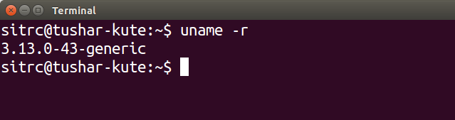
Find out kernel version
Find out the version of the kernel:
uname –r

Slide 8
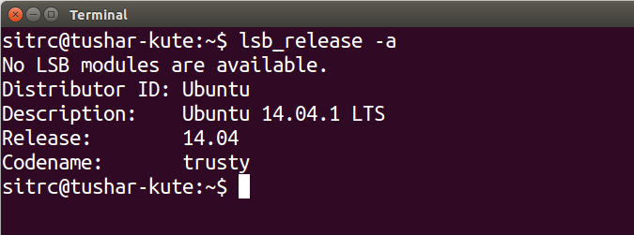
Find out operating system version
Find out the version of the kernel:
lsb_release -a

Slide 9
Linux Kernel Compilation
Download the kernel source code from http://kernel.org
– Actual link:
https://www.kernel.org/pub/linux/kernel/v3.x/linux-3.18.1.tar.xz
– Can be downloaded by command:
wget ttps://www.kernel.org/pub/linux/kernel/v3.x/linux-3.18.1.tar.xz
– Downloaded file is: linux-3.18.1.tar.xz
• Extract the file using command or GUI:
– tar xvf linux3.18.1. tar.xz

Slide 10
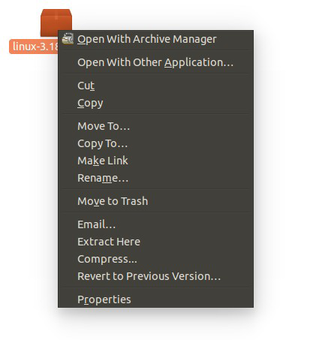
Extraction using GUI

Slide 11
Linux Kernel Compilation
Open the terminal and change the directory to the
Linux kernel source code.
– cd linux3.18.1
• sudo apt-get update
• sudo apt-get install libncurses5-dev
– ncurses (new curses) is a programming library that provides an API which allows the programmer to write text-based user interfaces in a terminal independent
manner. It is a toolkit for developing "GUI-like" application software that runs under a terminal emulator.

Slide 12
Linux Kernel Compilation
Configure the kernel:
– sudo make menuconfig
– Make the configuration changes as per your requirements.
• Other ways to do configuration (optional):
– sudo make oldconfig
– sudo make xconfig
• Compile the Linux kernel:
– sudo make
• The compilation process can be shifted to all the cores of
the system. (Next slide).

Slide 13
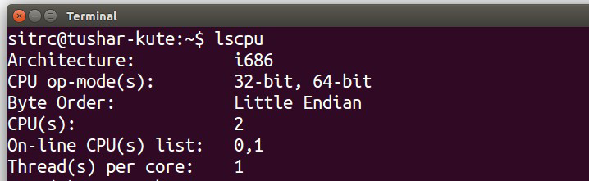
Check the number cores in CPU
The number of cores of the CPU can be found by:
– lscpu

Slide 14
Linux Kernel Compilation
The compilation process can be shifted to all the cores
of the system (2 cores or 4 cores).
– sudo make -j2
• After completion of the process, install the modules.
– sudo make modules_install install
• The above command will install the Linux Kernel 3.18.1
into your system. It will create some files under /boot/
directory and it will automatically make a entry in your
grub.cfg. Check whether it made correct entry and
check for the files it created.

Slide 15
Linux Kernel Compilation
The files under /boot/ directory are,
– system.map 3.18.1
– vmlinuz 3.18.1
– initrd.img 3.18.1
– config 3.18.1
• Restart your system manually or type:
– sudo reboot
• After restart, check the Linux kernel version:
– uname -r

